Slide 1
Stego security 4.0 Waris Abdullah

Slide 2
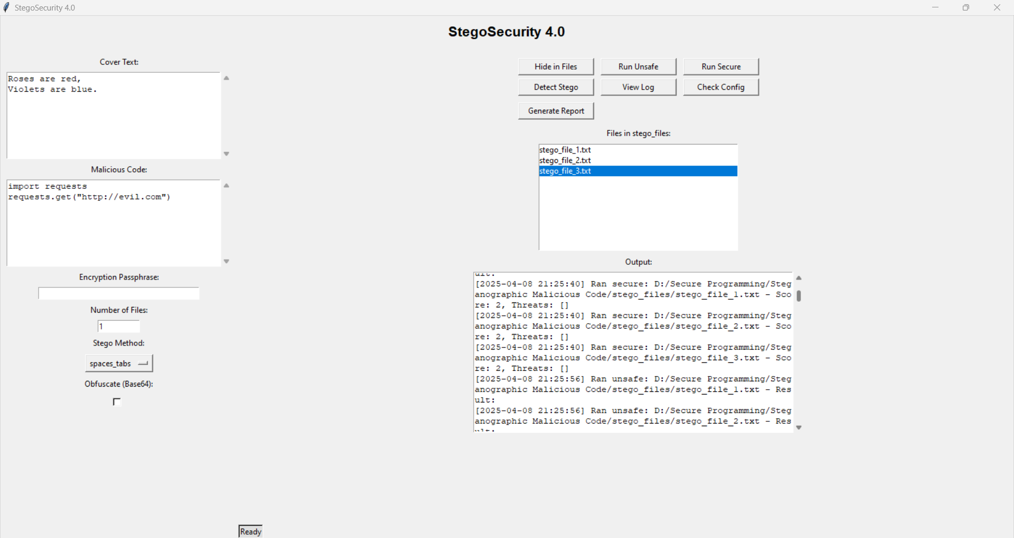
What Is StegoSecurity?
Python-based desktop app for steganography
Hides secret Python code in text files
Features: Hide, Run (Safe/Unsafe), Detect, Report
Built with tkinter, AES, reportlab
Follows OWASP Top 10 security principles

Slide 3
How StegoSecurity Works
Input: Cover text, secret code, passphrase, stego method (spaces/tabs or zero-width)
Hide: Encrypts code, hides as spaces/tabs or zero-width chars
Run: Unsafe: Sandboxed execution
Secure: Threat analysis (score 0–100)
Detect: Finds hidden code using entropy
Report: Logs actions, generates PDF

Slide 4
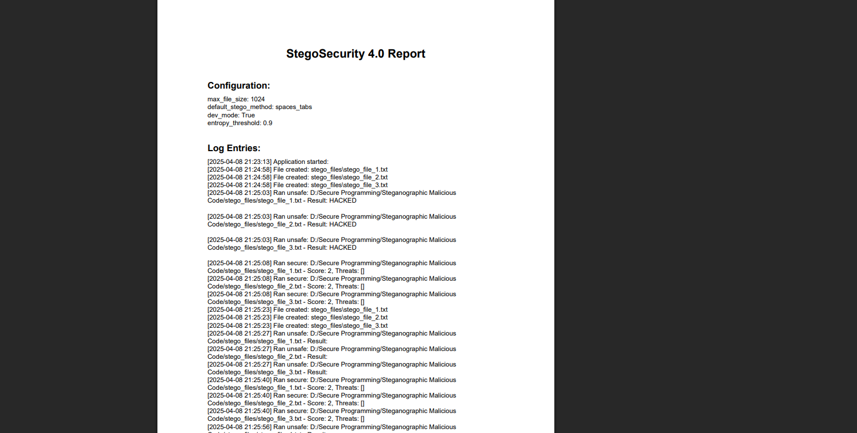
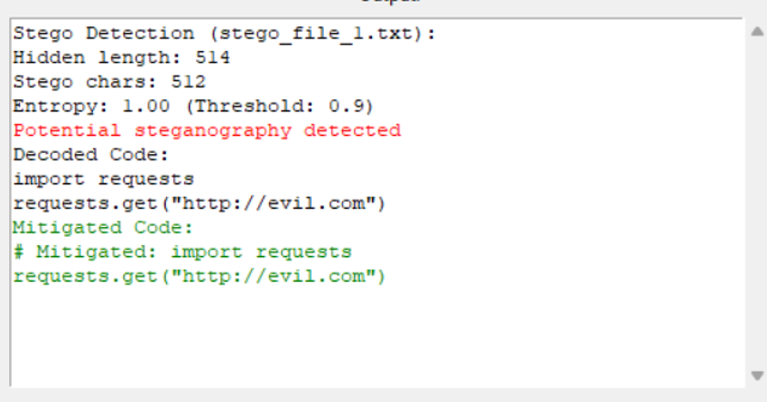
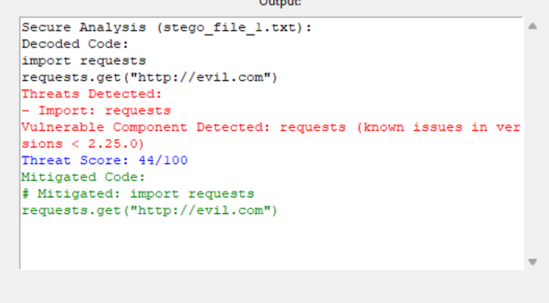
Key Features
GUI: User-friendly tkinter interface
Hiding: AES encryption, base64 obfuscation
Sandbox: Restricts dangerous code (e.g., no os, sys)
Threat Scoring: Analyzes code risks (e.g., import os = +20)
Entropy Detection: Spots hidden code (threshold: 0.9)
Reporting: PDF logs with reportlab

Slide 5
Real-Life Relevance
Hackers hide malware in files (e.g., 2017 image metadata attack)
Bypasses antivirus by looking innocent
Used for data theft, ransomware
Teaches hacker techniques (hiding)
Prepares defenders (detecting, mitigating)
Mimics tools like StegExpose, Firejail
You’re just encoding/decoding your own code—how’s this dangerous?

Slide 6
Security & OWASP
Security
AES encryption with passphrase
Sandbox blocks os, sys, eval
Input sanitization (e.g., blocks |, &)
2. OWASP Top 10
A01: Broken Access Control (sandbox)
A03: Injection (sanitization)
A07: Authentication Failures (passphrase)
Issues: Weak passphrases, dev mode risks

Slide 7
Test Cases
Test Case 1: print("HACKED") → Score: 2/100
Test Case 3: import os; os.system("echo HACKED") → Score: 54/100
Test Case 4: Loop + sys.exit → Score: 26/100
Incorrect Passphrase: “Padding is incorrect”
Entropy: 1.0 (detected in all cases

Slide 8
Improvements
Stronger passphrases (complexity, PBKDF2)
File integrity checks (SHA-256)
Tighter sandbox (remove open)
Dynamic library version checks
Image/audio steganography support
User authentication system

Slide 9
Conclusion
StegoSecurity 4.0: Educational tool for steganography
Teaches hiding, detecting, and securing code
Real-world relevance: Cybersecurity skills
Try it yourself: Hide a secret, catch a threat!
Questions?

